Slide 1

EFFECTIVE PRESENTATION SKILLS

Slide 2

A Presentation is a means of communication which can be adapted to various speaking situations, such as talking to a group, addressing a meeting or briefing a team.

Slide 3




General Purposes for Presentations
To inform
To persuade
To entertain

Slide 4

Steps to prepare effective presentation
Steps to prepare Effective presentation
Plan
Prepare
Practice
Present

Slide 5

Step 1

Slide 6
Planning usually includes following questions
Who is your audience?
Why are they there?
What is your goal?
How long will it take?
Where will it take place?
Who
Why
What
How
Where

Slide 7

Step 2

Slide 8

Points to keep in mind while preparing
Structure
Prompt
Visual aids
Voice
Appearance
Style
Questions

Slide 9
Structure
Introduction
Grab the audience attention
Main theme
Content should be relevant to topic
Summary/
conclusion
Key message

Slide 10

Prompt
Short bullet points, key words only
Put your entire prompt onto your power point slides
These prompts are for you.

Slide 11


Visual aids
Use simple fonts, colours and graphs
Use images and clipart.
3 to 7 bullets per slide.
Don’t overcrowd your slide, it will not look professional
New or different visual aids wake people up.

Slide 12

Louder and clearer than your normal pitch.
Vary pitch and volume.
Over emphasis

Slide 13
Appearance
Dark colours read as businesslike
Wear comfortable shoes to weight your feet evenly.
Allow yourself to move a bit.
Look confident.

Slide 14


Professional dress code

Slide 15
Style
You already have a style don’t copy others.
Use words and sentences you use in normal days
Be yourself.

Slide 16
How to handle questions
Anticipate questions in advance
Make an eye contact with the questioner
Take a brief pause before answering the question
Be sure you understand the question
Acknowledge the value of question asked
Keep your cool
Be honest
Answer a long question in sections

Slide 17
Internet
Books on the relevant topics
Newspaper articles
Available PPTs on the relevant topics
Personal viewpoint
How to prepare content for Presentations

Slide 18


Step 3

Slide 19

Rehearse all points you have prepared
Rehearse with visual aids and handouts
Practice again and again to manage time
Rehearse in front of a mirror or a friend.

Slide 20

Step 4
PRESENT

Slide 21
Present
Make a strong start
Engage the audience in first 2-3 minutes
Show your passion through your movements and gestures
Make an eye contact
Don’t forget to smile unless the topic is very grim.

Slide 22
Presentation Mistakes
Too much information
Use of acronyms, abbreviations & jargons
Monotone presentation style is soporific
Ignoring the audience
Call to action(conclusion)is confusing &vague
Presenting irrelevant information
Lack of practice

Slide 23


Slide 24
How to make your Presentation a success
Speech contents – word usage
The presenter’s own voice and personality
Non verbal signs and body language
Audio / Visual aids – photographs, drawings, graphs, OHP transparencies.

Slide 25
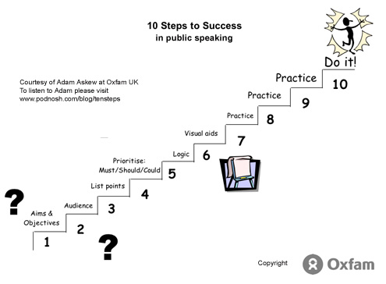

Slide 26
